Slide 1
ABOUT AMERICAN FRIENDS SERVICE COMMITTEE
Pauline Kamau (PhD)

Slide 2
Process of the presentation:
About AFSC, history
Our Mission/Vision and programs
Methods and approach of AFSC to programming
Social Justice – AFSC work on Social Justice
Social Justice from an African perspective
Division of social justice from an African perspective
Challenges to social justice
Reaching out communities for Social Justice at AFSC and Summary
Reflection questions
Takeaways
Citations from Social Justice and Peace builders
SPICES

Slide 3
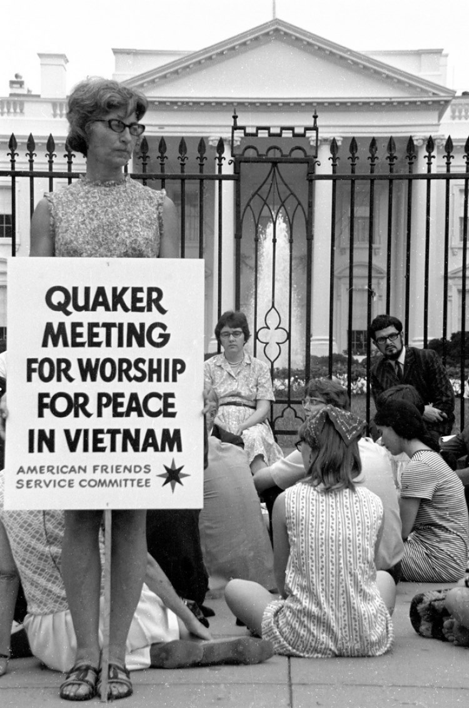
History
The American Friends Service Committee (AFSC) was founded in 1917 during World War I to give young conscientious objectors ways to serve without joining the military or taking lives. Since 1917, the American Friends Service Committee has been building peaceful communities all over the world.

Slide 4
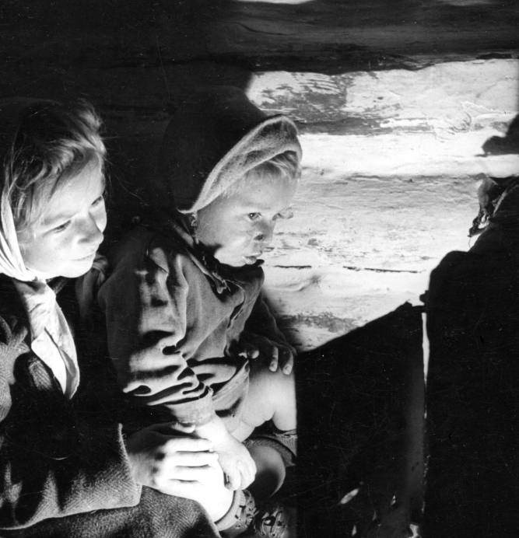
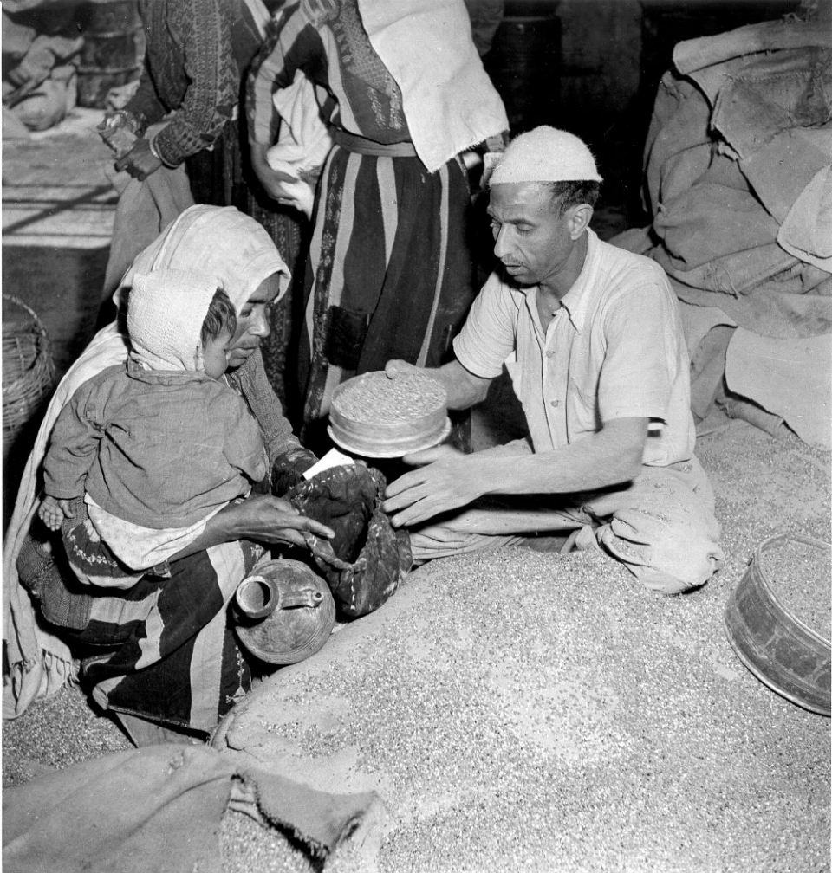
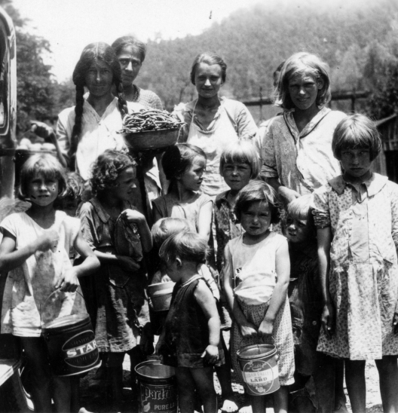
AFSC Supporting survivors of War

Slide 5
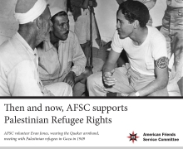
History
In more than 100 years of existence, AFSC includes people of various faiths who are committed to social justice, peace, and humanitarian service. Guided by the Quaker belief in the divine light of each person, AFSC works with communities and partners worldwide to challenge unjust systems and promote lasting peace.

Slide 6
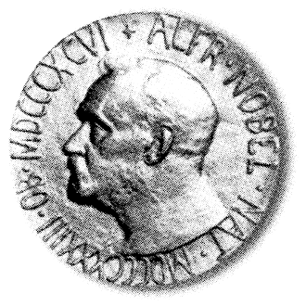
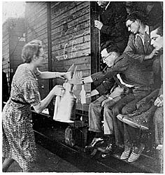

Recognition of Quaker War Relief Efforts
In 1947 the British Friends Service Council &
American Friends Service Committee accepted the
Nobel Peace Prize on behalf of all Quakers for relief and reconstruction work during and after World War II

Slide 7
AFSC
Vision: A just peaceful and sustainable world free of violence, inequality and oppression.
Vision of just peace based on the Quaker belief in “that of God” in everyone.
Mission: Guided by the Quaker belief in the divine light of each person. AFSC works with communities and partners worldwide to challenge unjust systems.
Our work is resolutely principled and nonviolent, and, as such, has often transcended conventional boundaries.

Slide 8
Overarching goal
Works in a dynamic relationship with communities and partners, hence seeks, secures and sustains transformative shifts in systems of power to reduce all forms of violence and advance human dignity and equality.
AFSC seeks to deepen understanding of the root causes and interconnectedness of societal problems and identify the most strategic leverage point to shift systems in peace building.
Global Thematic goals -
Just and Sustainable Peace,
Just Approaches to Forced Displacement and Migration
An Economy that Works for People and Earth
Cross cutting themes
Gender Justice
Climate Justice
Youth
Anti racism etc

Slide 9
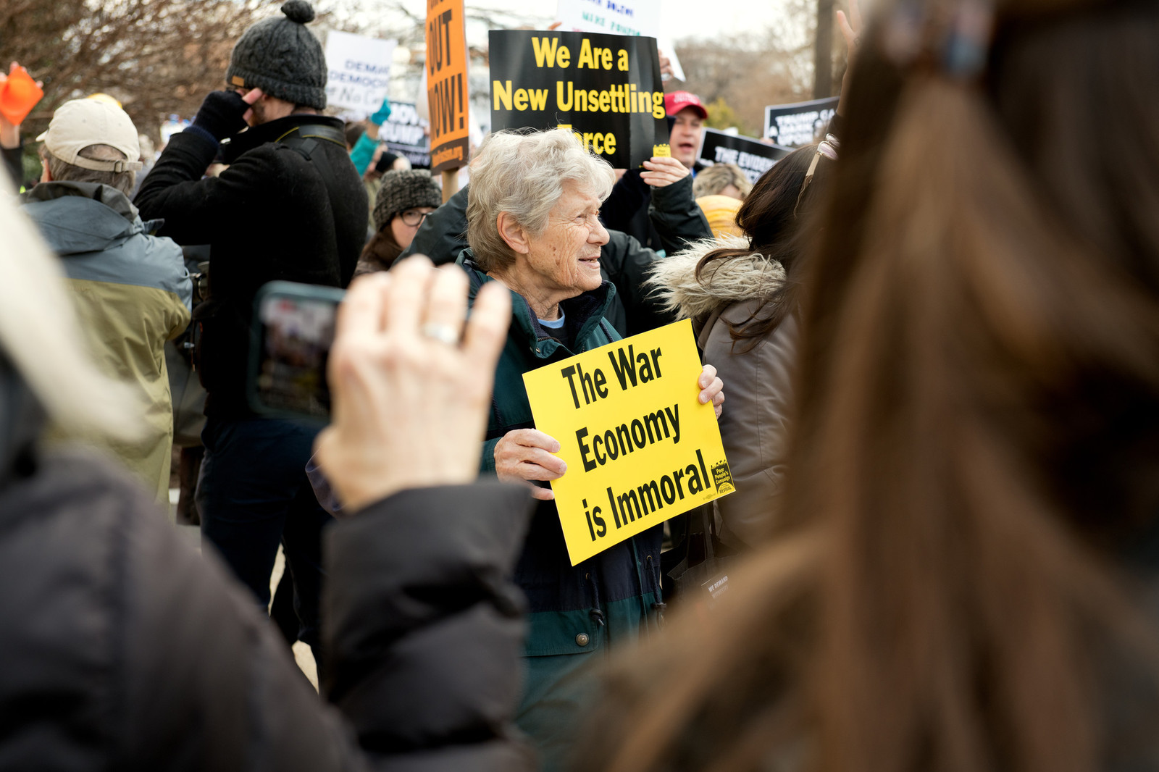
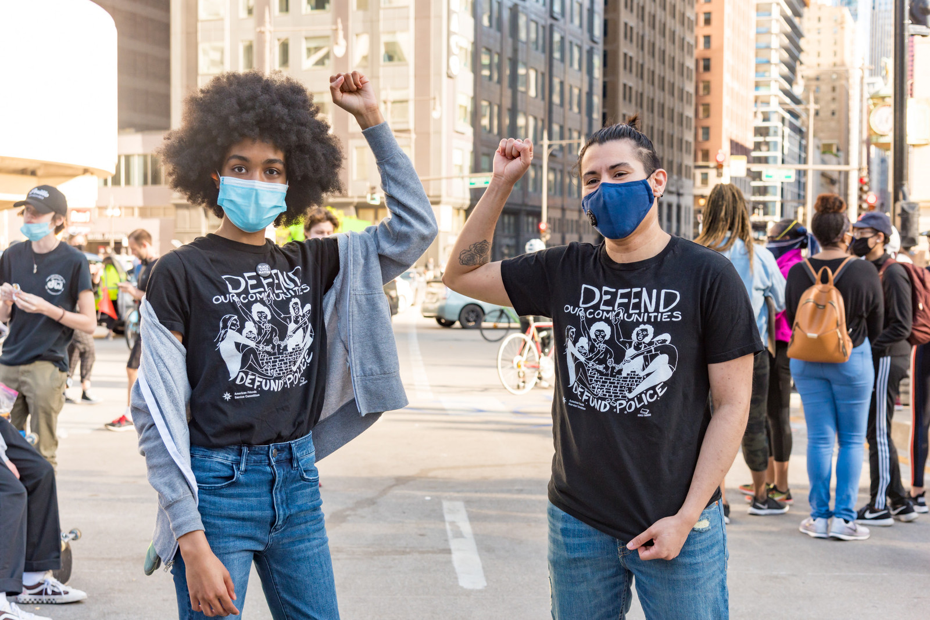
Our Programs
AFSC has Programs in the US and International Regions including Africa, Asia, Middle East and Latin America Countries.
In Africa AFSC works in Burundi, Ethiopia, Kenya, Somalia, South Sudan and Zimbabwe which is a cross -boarder project with South Africa.
Ethiopia Program (Salama HUB) covers the whole of the Horn of Africa countries.
Through its Dialogue and Exchange program AFSC extends the impact of its work to 25 other African countries.

Slide 10
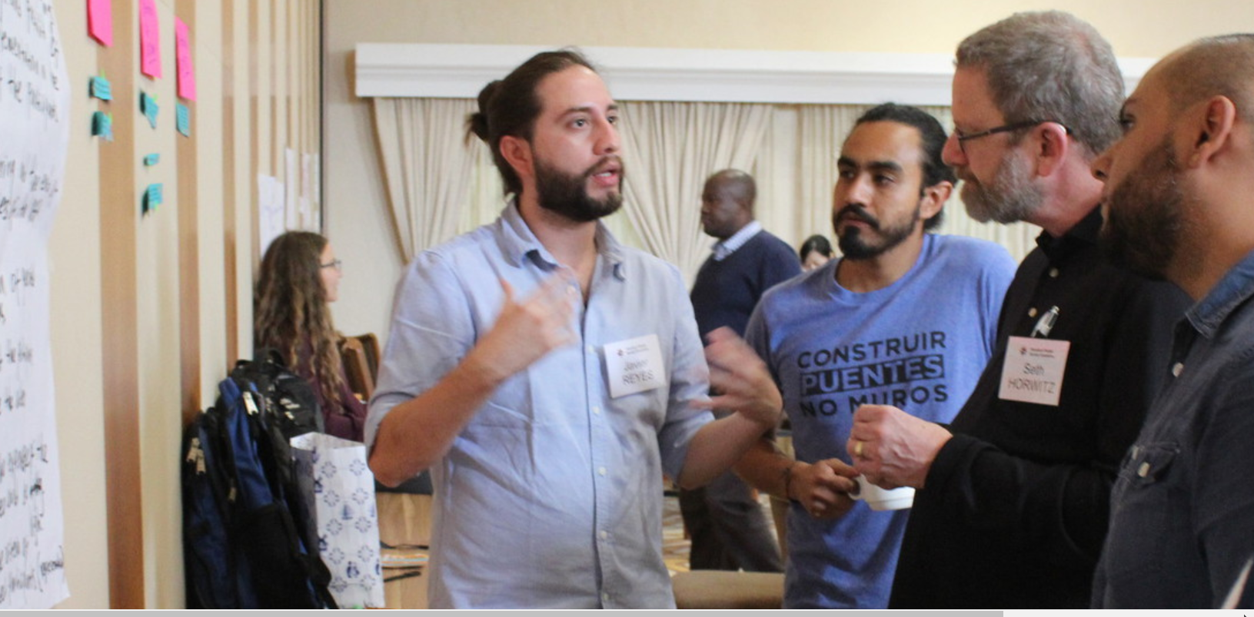
The Dialogue and Exchange Program (DEP)
Enables people living in the Global South to participate in short-term, strategic seminars, conferences, trainings, and exchanges that cross boundaries.
Fills a strategic gap that other institutions are either unwilling or unable to do.

Slide 11

Peace Building program
Trauma healing
Capacity sharing
Truth Justice and Reconciliation
Advocacy

Slide 12
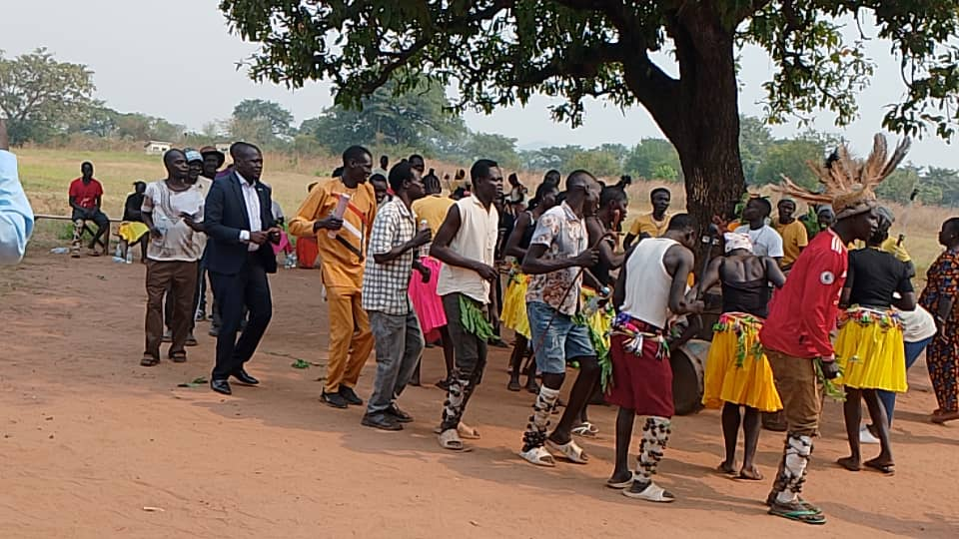
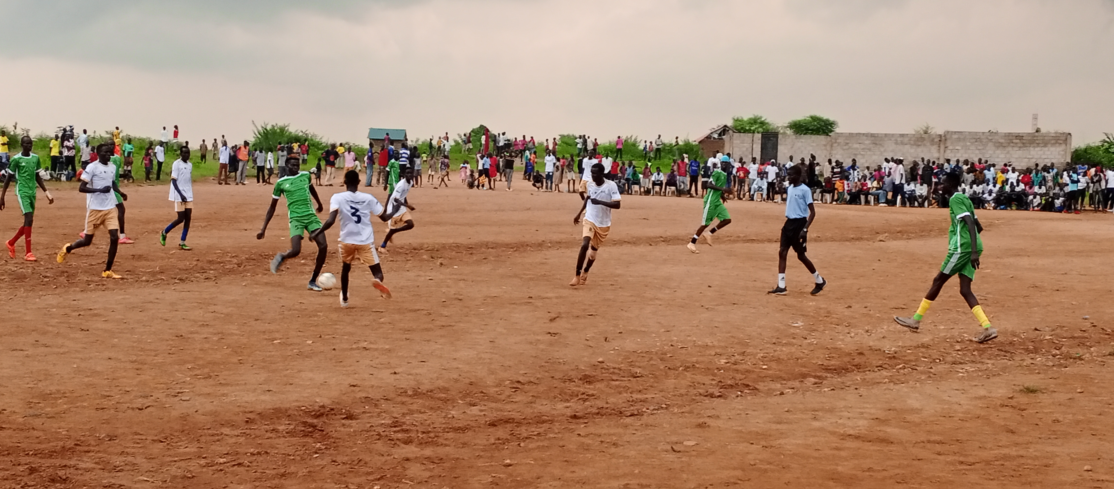
South Sudan

Slide 13
Methods
AFSC uses the following methods in its program work.
Community Organizing and Civil Society Strengthening
Bridging and Convening
Research and Analysis
Advocacy

Slide 14
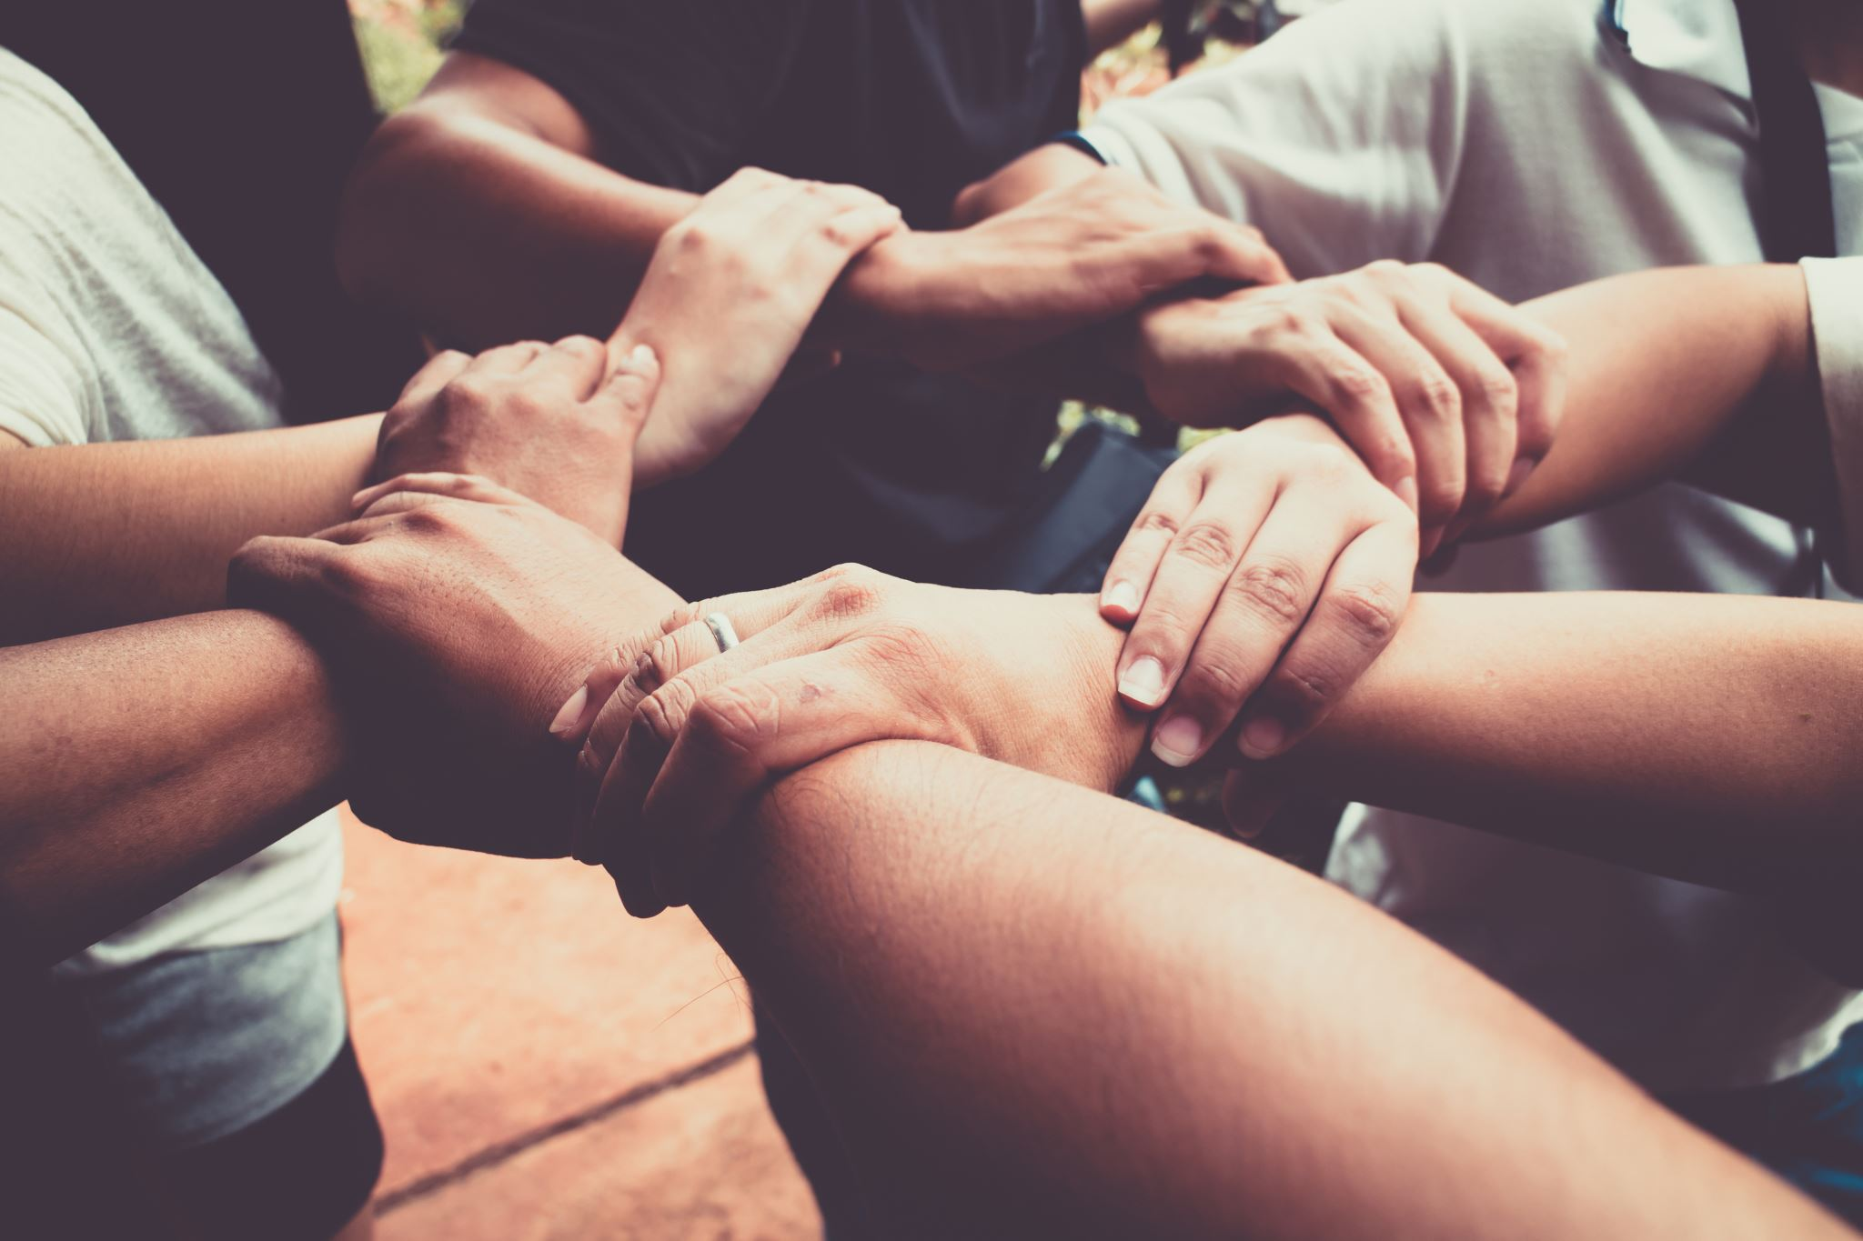
AFSC work on Social Justice
AFSC defines social justice in terms of Simplicity, peace, integrity, community, equality, and stewardship.
This is rooted in the belief that there is "that of God in everyone", meaning every person has inherent worth and should be treated with dignity and fairness.
The work is rooted on shared security (shared well being among communities)
Social justice can be defined as the fair and equitable distribution of resources, opportunities, and privileges within a society, along with the recognition and protection of everyone's rights and dignity, regardless of their background or identity.

Slide 15
What is social justice from an African perspective?
This involves understanding how African philosophies, cultures, histories, and indigenous values shape concepts of justice, equity, and community.
While Africa is incredibly diverse, many traditional and contemporary African approaches to social justice emphasize collective well-being, human dignity, and the interconnectedness of individuals within their communities.

Slide 16
Division of social justice from an African perspective
1. Ubuntu philosophy, “I am because we are”. It emphasizes interdependence, compassion, and communal responsibility. A person is a person through other people." – African proverb reflecting Ubuntu.
(Ubuntu) This is what is called Shared security …“my well-being is yours, and yours is mine.”
-My humanity is bound up in yours, for we can only be human together – Desmond Tutu
2. Restorative and Reconciliatory Justice
- Many African justice systems traditionally emphasize restorative justice i.e. resolving conflict by repairing relationships and restoring balance within the community.
- Instead of focusing solely on punishment, these systems look at how to heal the harm done.
Elders or councils often mediate disputes in a way that considers the needs of both victims and offenders, as well as the community at large.
3. Communalism and Shared Resources
-Social justice in African contexts often involves equitable access to land, education, health, and economic resources, grounded in the principle that resources belong to the community, not just individuals (e.g. Nyerere’s Ujamaa.

Slide 17
Challenges of Social Justice
Challenge | Description
Systemic inequality | Discriminative laws
Economic disparities | Poverty and resource imbalance
Lack of awareness/education | Apathy towards Justice
Weak institutions/corruption | Justice systems that fail or abuse power e.g. courts, police
Cultural and social norms | Traditions that reinforce injustice
P Political instability and conflict | Human rights not violated or suspended
Media biases and misinformation | Narratives that harm truth and accountability
Resistance to change | Powerful actors or groups oppose transformation e.g. political class

Slide 18
AFSC doesn’t act for people, but with them
AFSC partners directly with marginalized communities — including immigrants, incarcerated people, low-income workers, and communities of color.
AFSC’s goal is to amplify local voices and support community-led solutions (through capacity enhancement and accompaniment)
Advocacy and Policy Change with relevant policy makers together with community. E.g. Salama HUB work
AFSC actively works to change unjust laws and systems at local, national, and international levels (advocacy at community, national, regional and global levels – US, EU, UN etc
Education and Public Awareness (DEP’s, campaigns etc)
AFSC uses storytelling, publications, public campaigns, and Quaker-based resources to educate the public on key issues

Slide 19
Summary of AFSC’s Approach to Social Justice
Principle | How AFSC Lives It Out
Equality | Advocating for gender, economic justice and anti racism, ethnicity, xenophobia etc
Peace | Opposing militarism and promoting conflict resolution (Dialogue, Quiet Diplomacy)
Community | Supporting community organizing and leadership (Grassroot oriented peace building, training women and youth mediators etc)
Integrity | Holding institutions accountable and speaking truth to power (Refusing money form US government in order to challenge them on their biases)
Nonviolence | Promoting peaceful change through dialogue, protest, and education (Alternative to Violence Program – AVP) – Ubuntu philospohy
Faith in Action | Aligning work with Quaker values and a belief in the divine in everyone

Slide 20
Questions for reflection
How can Quakers contribute to social justice efforts beyond their own communities, especially in diverse, interfaith, or secular settings?
What are some challenges Quakers face when trying to balance peaceful action with the urgency of confronting injustice?
How does the Quaker belief in “that of God in everyone” influence their approach to social justice today?

Slide 21
Key take aways
Protect and defend human rights: In countries where authoritarianism is rising, Quakers can serve as protectors of civil liberties.
Practising solidarity: “There is that of God in everyone” means that justice must be co-created, not imposed.
Fostering Dialogue and Peacebuilding: In regions torn by war or polarization, Quakers can act as neutral peacebuilders and conflict mediators: Providing safe spaces for dialogue.
Speaking truth to the power: In times of injustice, they are called to be prophetic voices.
Building global alliances: even with other interfaith groups.
Resisting authoritarianism with nonviolence: joining peaceful protests: Quaker “silent worship” must lead to courageous action.

Slide 22
Social Justice and Peace builders Quotations
“Let us see what love can do.” William Penn, Quaker founder & social reformer
“Peace is not merely the absence of war. It is the presence of justice.”
Martin Luther King Jr.
“Freedom is never voluntarily given by the oppressor; it must be demanded by the oppressed.” Martin Luther King Jr.
“You cannot protect the environment unless you empower people, you inform them, and you help them understand that these resources are their own” Prof. Wangari Maathai, Nobel Laureate
“You can never leave footprints that last if you are always walking on tiptoe. Leymah Gbowee (Liberia) – Nobel Laureate
“Do your little bit of good where you are; it’s those little bits of good put together that overwhelm the world.” Desmond Tutu – Nobel Laurent

Slide 23
Quaker Values and testimonies: SPICES
Simplicity: Challenge consumerism and economic injustice.
Peace: Oppose war, militarism, and arms trade. Support nonviolent resistance movements.
Integrity: Speak truth to power, even when it is dangerous.
Community: Build mutual aid networks and grassroots solidarity.
Equality: Stand against racism, xenophobia, patriarchy, and homophobia
Stewardship: Defend climate justice, especially for those most affected

Slide 24

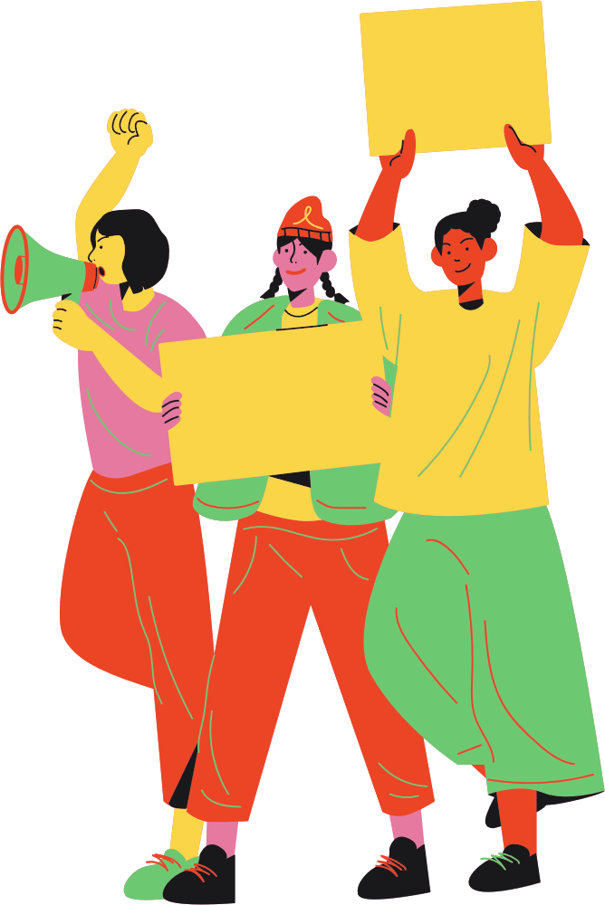

THANK YOU FOR YOUR TIME

